Slide 1
Chapter 11
Compilers and Language Translation

Slide 2
Learning Objectives (1 of 2)
List the phases of a typical compiler and describe the purpose of each phase
Demonstrate how to break up a string of text into tokens
Understand grammar rules written in BNF and use them to parse statements
Explain how semantic analysis uses semantic records to determine meaning

Slide 3
Learning Objectives (2 of 2)
Show what a code generator does
Explain the historical importance of code optimization, and why it is less central today
Give an example of local code optimization and an example of global code optimization

Slide 4
Introduction
High-level languages must be translated into machine instructions
Compilers do the translation
Compiler writing is difficult and complex
Compilers must be
Correct ► machine instructions must do exactly what the high-level instructions mean
Efficient and concise ► code produced should be optimized and run fast

Slide 5
The Compilation Process (1 of 26)
Four phases of compilation
Phase I: Lexical analysis
Groups characters into tokens (equivalent to words)
Phase II: Parsing
Checks grammatical structure and builds internal representation of program
Phase III: Semantic analysis and code generation
Analyzes meaning; generates machine instructions
Phase IV: Code optimization
Improves efficiency of code in time or space required

Slide 6
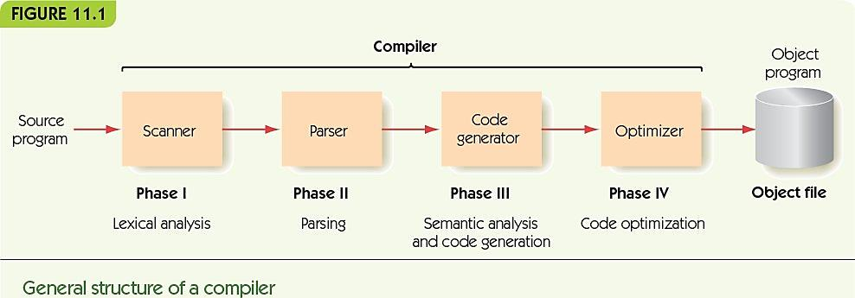
The Compilation Process (2 of 26)

Slide 7
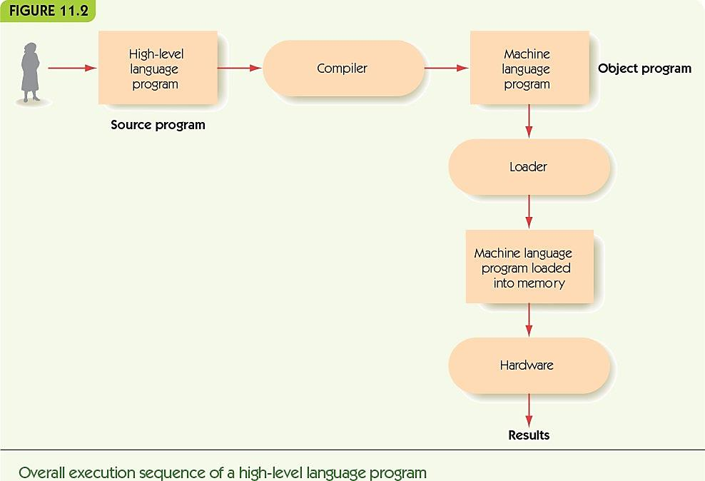
The Compilation Process (3 of 26)

Slide 8
The Compilation Process (4 of 26)
Phase I: Lexical Analysis
A lexical analyzer or scanner
Groups input characters into tokens
Discards unnecessary characters
Examples: blanks, tabs, and comment text
Determines the type of each token
Examples: symbol, number, and left parenthesis
Tokens are words and punctuation
Meaningful to the language

Slide 9
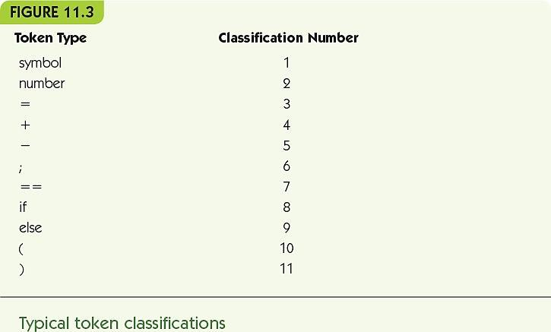
The Compilation Process (5 of 26)

Slide 10
The Compilation Process (6 of 26)
Phase II: Parsing
A parser takes a list of tokens and
Determines grammatical structure
Builds a parse tree
Syntax
Grammatical structure
Defined by rules (productions)
BNF (Backus-Naur Form) is the notation for describing rules
A grammar is the set of rules that define a language

Slide 11
The Compilation Process (7 of 26)
Parsing
BNF
Rules
left-hand side ::= right-hand side
<sentence> ::= <subject> <verb> <object>
Left-hand side: grammatical category
Right-hand side: pattern that captures the structure of category

Slide 12
The Compilation Process (8 of 26)
Patterns are made from terminals and nonterminals
Terminals: tokens from lexical analyzer
Nonterminals: grammatical categories
Written within <angle brackets>
Goal symbol
One special nonterminal
Means complete grammatical program is found
Metasymbols: <, >, ::=, |, Λ
Λ (lambda) is a null string—emptiness

Slide 13
The Compilation Process (9 of 26)
The fundamental rule of parsing
“If, by repeated applications of the rules of the grammar, a parser can convert the sequence of input tokens into the goal symbol, then that sequence of tokens is a syntactically valid statement of the language. If it cannot convert the input tokens into the goal symbol, then this is not a syntactically valid statement of the language.”

Slide 14
The Compilation Process (10 of 26)
Parsing example: x = y + z
Apply <variable> ::= … rules
<variable> = <variable> + <variable>
Apply <expression> ::= <variable> + <variable> rule
<variable> = <expression>
Apply <assignment statement> rule
<assignment statement>

Slide 15
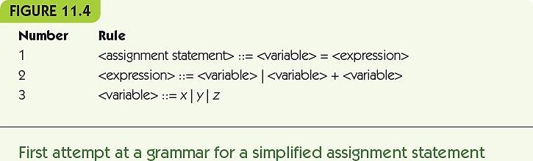
The Compilation Process (11 of 26)

Slide 16
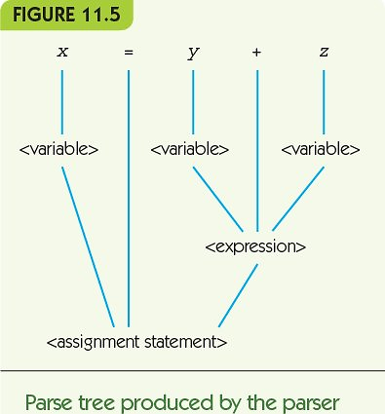
The Compilation Process (12 of 26)

Slide 17
The Compilation Process (13 of 26)
Look-ahead parsing algorithms
Look at future tokens to choose the right rule to apply
Allows for arbitrary-length patterns
x = x + y + z + q + p
Recursive definition: definition includes left-hand term on the right-hand side
<expression> ::= <expression> + <expression>

Slide 18
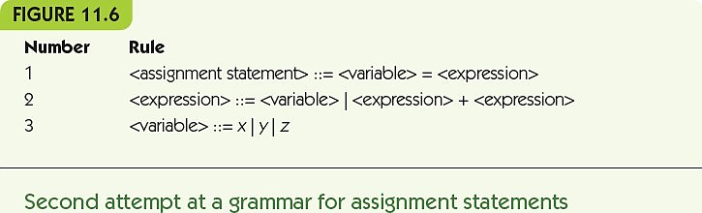
The Compilation Process (14 of 26)

Slide 19
The Compilation Process (15 of 26)
Ambiguous: a grammar where the same string can be parsed multiple ways
x = x – y – z means x = (x – y) – z
OR
x = x – y – z means x = x – (y – z)
Grammars must be unambiguous!

Slide 20
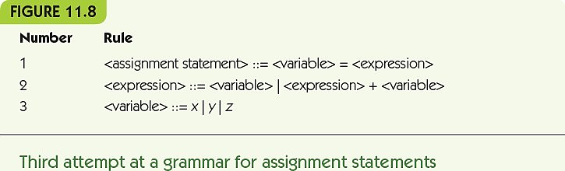
The Compilation Process (16 of 26)

Slide 21
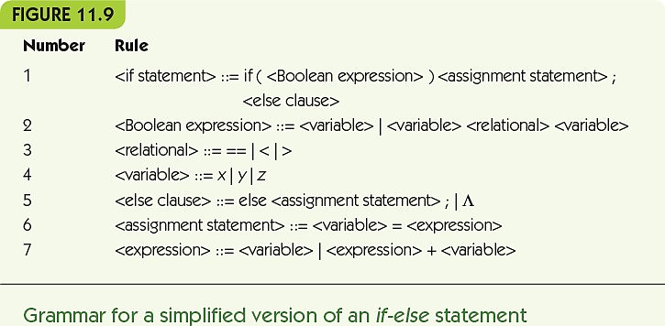
The Compilation Process (17 of 26)

Slide 22
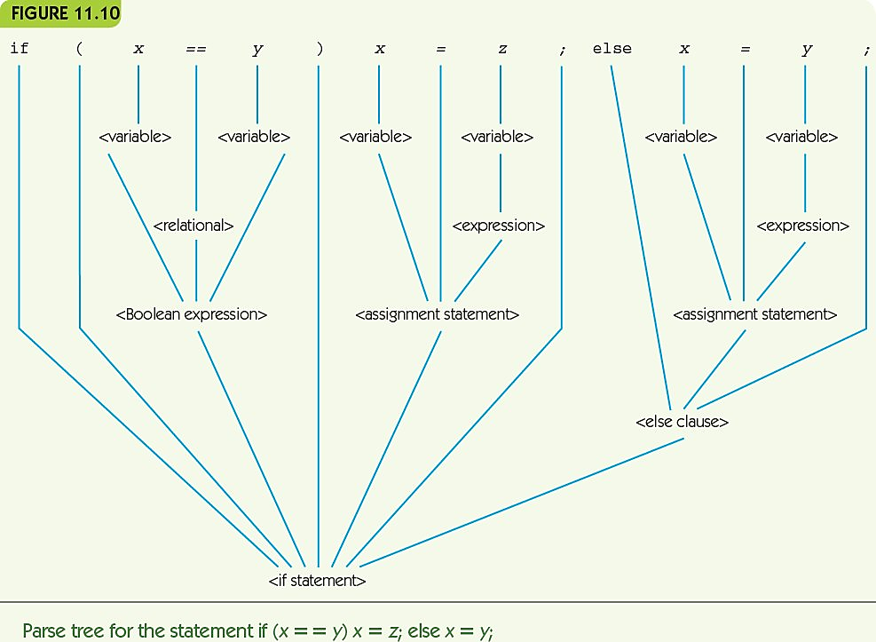
The Compilation Process (18 of 26)

Slide 23
The Compilation Process (19 of 26)
Phase III: Semantics and Code Generation
Semantic analysis
Checks all branches of the parse tree make sense
Grammatical statements can be meaningless
Example: bees bark
Semantic records
Store information about actual values associated with nonterminals
<variable> came from a token “x” and its type was integer

Slide 24
The Compilation Process (20 of 26)
Code generation
Translates parse tree pieces to assembly code
Can build semantic records as it goes
Semantic analysis is simultaneous with generation
Not all parts of the parse tree produce code

Slide 25
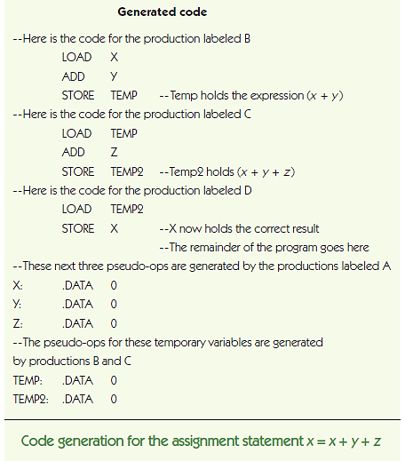
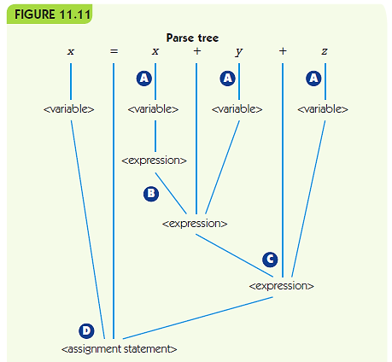
The Compilation Process (21 of 26)

Slide 26
The Compilation Process (22 of 26)
Phase IV: Code optimization
Improving the time or space efficiency of code produced by a compiler
Early days: “Programmers are cheap, hardware is expensive”
Humans could write more optimal code than a compiler
These days: “Hardware is cheap, people are expensive”

Slide 27
The Compilation Process (23 of 26)
Modern compilers optimize but focus on other issues
Visual development environments help programmers see what is happening
Online debuggers help find and correct errors
Reusable code libraries and toolkits

Slide 28
The Compilation Process (24 of 26)
Local optimization
Examines small chunks of assembly code (one to five instructions)
Constant evaluation computes arithmetic expressions at compile time if possible
Strength reduction uses faster arithmetic alternatives (e.g., 2 * x is equivalent to x + x)
Eliminating unnecessary operations removes operations that are unnecessary, like a LOAD of a value already in memory

Slide 29
The Compilation Process (25 of 26)
Global optimization
Looks at large segments of the program
Examines blocks like while loops, if statements, and procedures
Much more difficult, much bigger effect
Optimization cannot overcome an inefficient algorithm

Slide 30
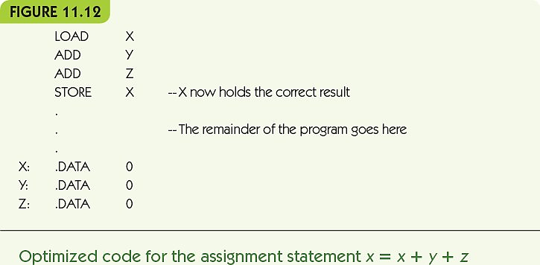
The Compilation Process (26 of 26)

Slide 31
Summary (1 of 2)
High-level languages require compilers to translate programs into assembly language.
Compilation is much more difficult and complex than assemblers translating assembly to machine instructions.
Compiler phases include lexical analysis, parsing, semantic analysis, code generation, and code optimization.
Lexical analysis converts a text of characters into a list of tokens.

Slide 32
Summary (2 of 2)
Parsing is based on a formal grammar specifying the rules for a language.
Parsers check grammaticality and build parse trees.
Semantic analysis checks parse trees for meaning: determines whether code can meaningfully be generated.
Code generation produces assembly instructions from the parse tree.
Code optimization looks for opportunities to make generated code better.

